Slide 1
Actual productivity
By Lamunu Gloria

Slide 2
Stakeholders
Shareholders
Executive Management
Middle Management
Workshop employees

Slide 3
Problem statement
In a production or workshop facility, it is important to predict performance hence the targeted_productivity column in the data set provided. However, due to several factors provided as the features, the actual_productivity differs from the targeted_productivity. A production facility needs to know how it actually performs such that it can make improvements and better targets

Slide 4
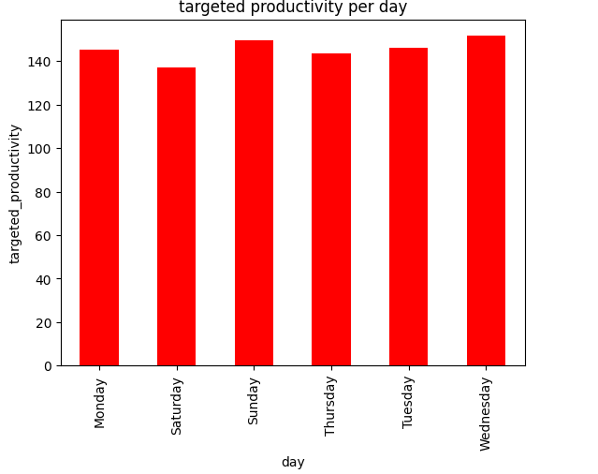
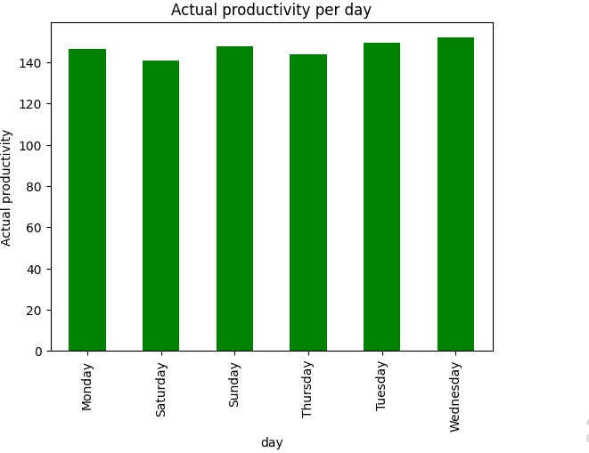
Comparison of productivity per day

Slide 5
Explanation
From the previous slide, the actual_productivity is very close to the targeted productivity although there is a slight deviance

Slide 6
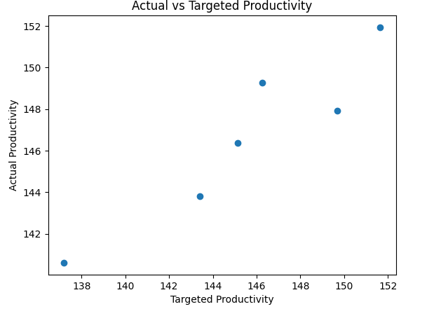
Actual Vs Targeted Productivity

Slide 7
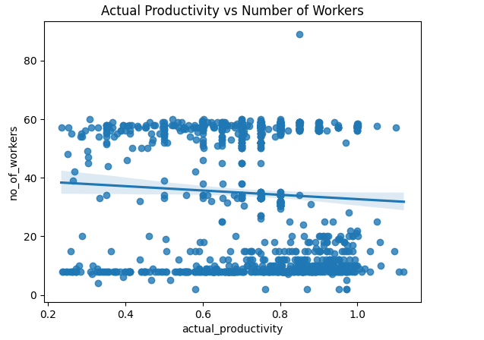
Actual_productivity and no_of_workers
Explanation
There is a slight negative correlation which can be seen. As the no_of_workers decreases, productivity increases

Slide 8
The model
I will take the Random Forest model for this project. I evaluated the model, with R2 score which explained 48% of the variability in actual _productivity using the features provided. By being unable to predict accurately your actual_productivity, resources might not be well planned for the work available.
Strengths
The Mean Absolute Error was 7% meaning that the difference between the predicted values and target values in this case, actual_productivity was 7%.
Limitations
Column wip had too much missing data and low R2 score

Slide 9
Recommendations
Capture more data relevant to the actual productivity
Reduce the missing data

